Slide 1
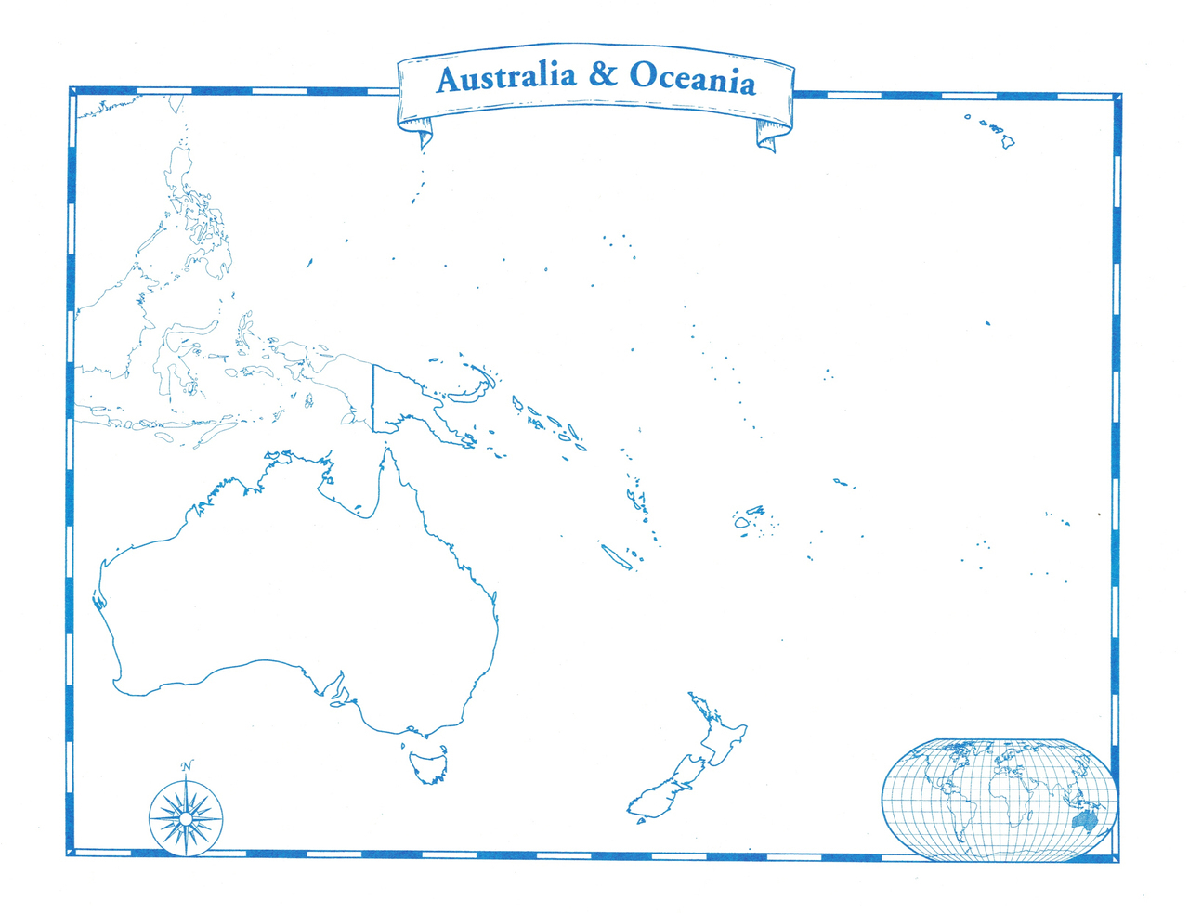
Australia
& Oceania
Exploratory Data Analysis
Team 10 Haight
Notes:
G'day everyone, thank you all for being here today. We are team 10 and we are here to walk you through our Exploratory Data Analysis for Australia and Oceania as well as bring the Pacific Islands closer to you, help you understand what is the region made up of and why it is they way it is.

Slide 2

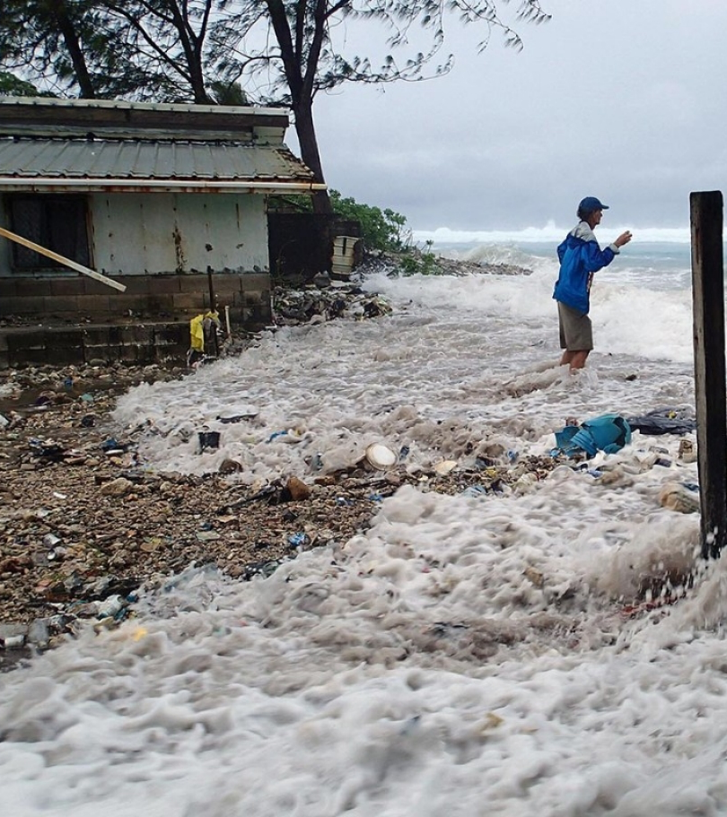
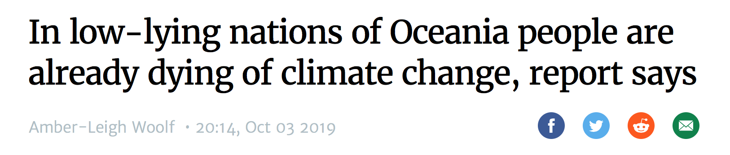
Notes:
Australia and Oceania. What first came to our mind were beaches and surfing, Sydney, natural wonders, New Zealand's sheep population, all the beautiful things. But there is the other side of this region that many people are not aware of. The Pacific Islands that are currently threatened by climate change, sea level rise or radiation even worse than in Fukushima or Chernobyl (New York Post, 2019).
References:
The New York Times. (2015, December 2). The Marshall Islands Are Disappearing. The New York Times. Retrieved from: https://www.nytimes.com/interactive/2015/12/02/world/The-Marshall-Islands-Are-Disappearing.html.
Los Angeles Times. (2019, July 15). Radiation in parts of the Marshall Islands is far higher than Chernobyl, study says. Los Angeles Times. Retrieved from: https://www.latimes.com/nation/la-na-marshall-islands-radiation-20190715-story.html.
NewScientist. (2017, September 7). Eight low-lying Pacific islands swallowed whole by rising seas. NewScientist. Retrieved from: https://www.newscientist.com/article/2146594-eight-low-lying-pacific-islands-swallowed-whole-by-rising-seas/.
Stuff. (2019, October 3). In low-lying nations of Oceania people are already dying of climate change, report says. Stuff. Retrieved from: https://www.stuff.co.nz/environment/climate-news/116239262/in-lowlying-nations-of-oceania-people-are-already-dying-of-climate-change-report-says.
New York Post. (2019, July 15). Radiation levels in Marshall Islands still exceed Fukushima, Chernobyl: study. New York Post. Retrieved from: https://nypost.com/2019/07/15/radiation-levels-in-marshall-islands-still-exceed-fukushima-chernobyl-study/.

Slide 3
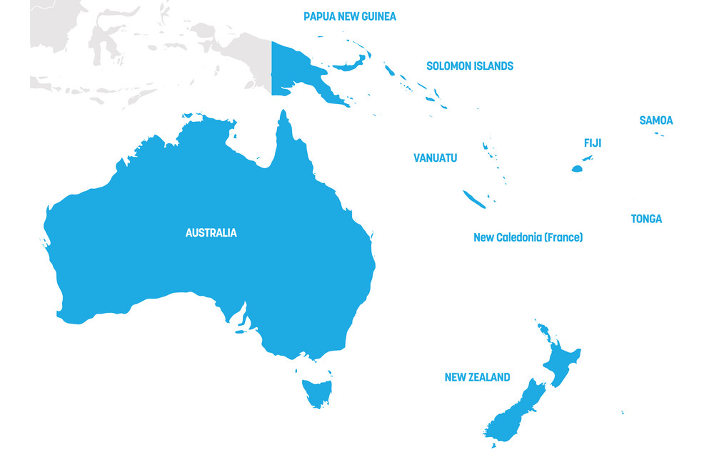
Notes:
So we won't talk only about Australia and New Zealand, the well-known countries of this region.

Slide 4
NORTHERN MARIANA ISLANDS
GUAM
NAURU
MARSHALL ISLANDS
KIRIBATI
TUVALU
MICRONESIA, FED. ST.
PALAU
AMERICAN SAMOA
FRENCH POLYNESIA
Notes:
There are seventeen other countries that deserve attention too.

Slide 5
AGENDA
Data Cleaning
Missing Data Strategy
Detecting Outliers
Strategy for Analysis
Sub-Regions
Testing Models with Correlations
Key Insights and Trends
Notes:
Moving on, let me just quickly walk you through our today's agenda. We will start by how we did the data cleaning, including the missing data strategy and outliers that we observed. Then we will move on to the strategy for our analysis, in which we divided our region into sub-regions and tested our models with correlations. And lastly, we will conclude with key insights and trends observed from the analysis.

Slide 6


MISSING DATA STRATEGY
STEP 1
Finding missing data and inputting it manually using statistical sources
STEP 2
Treating missing values with descriptive statistics
STEP 3
Selecting columns required for testing
STEP 4
Testing correlations based on statistic categories
Notes:
Our exploratory data analysis using Python uncovered a lot of missing values in the dataset.
Our Missing Data Strategy :
Step 1:
Finding missing data and directly inputting it manually to the Excel file from credible sources such as the World Bank, United Nations, UNICEF and so on. This is since we believe that using descriptive statistics to replace missing values does not make sense as there are too many factors that affect these particular statistics.
Step 2:
Treating the missing values that we could not find with descriptive statistics.
Step 3 :
Selecting the columns required for testing.
Step 4:
Testing correlations based on statistic categories. There are three main categories and they are
GDP
Population
Healthcare

Slide 7
DROPPED COLUMNS
Educational Attainment
GINI Index
Income Share
Poverty Headcount Ratio
Dysfunctional EMIS
Papua New Guinea: 1st PhD student in 2018
No regular survey conducting
No proper data on economic inequality
Economic dependency on other countries
Notes:
Column Names :
1)Educational attainment, at least Bachelor's or equivalent, population 25+, total (%) (cumulative)
2)Educational attainment, at least Master's or equivalent, population 25+, total (%) (cumulative)
3)Educational attainment, at least completed lower secondary, population 25+ total (%) (cumulative)
4)Educational attainment, at least completed post-secondary, population 25+, total (%) (cumulative)
5)Educational attainment, at least completed primary, population 25+ years, total (%) (cumulative)
6)Educational attainment, at least completed short-cycle tertiary, population 25+, total (%) (cumulative)
7)Educational attainment, at least completed upper secondary, population 25+, total (%) (cumulative)
Reason :
In terms of primary and secondary education systems in this region the main problem is that they have very few or dysfunctional Education management information system (EMIS), in the absence of EMIS they use ledgers to fill in the data, this creates indicators that is not suitable for international standards, furthermore the data that we get from this system are either incomplete or highly unreliable because nobody actually monitors the data that is being entered and they do not update the data for years. There has been cases in this region where the most sophisticated school has not updated its data for 8 years (Levine, 2013).
In terms of Higher education countries like Papua New Guinea have their first PhD student in 2018, this region do not have data on this column is either because they have very few people doing their higher education or the industry sector often imports qualified workers with higher education to these regions so the data is not considered reliable metric (Papua New Guinea Today, 2018).
Column Names :
1)GINI index (World Bank estimate)
2)Income share held by fourth 20%
3)Income share held by highest 20%
4)Income share held by lowest 20%
5)Income share held by second 20%
6)Income share held by third 20%
7)Poverty headcount ratio at $1.90 a day (2011 PPP) (% of population)
8)Poverty headcount ratio at $3.20 a day (2011 PPP) (% of population)
9)Poverty headcount ratio at national poverty lines (% of population)
10)Prevalence of underweight, weight for age (% of children under 5)
Reason:
World bank usually measures economic inequality by the data they get from household surveys and this particular region does not conduct surveys regularly so there are missing data in many of the countries from this region. When there is no proper data on economic inequality it is not possible to have an updated GINI index for this region.
Furthermore most of the countries in this region are highly dependant on other countries for imports and financial aids so if there is a fluctuation in the value of currency in these countries then there will be a huge impact on imports in these countries and the economy of most of these countries are highly dependent on one particular sector so this makes it complex to regularly get the data and calculate its impact on economic inequality.
Since it is difficult to estimate economic inequality and it is also a main factor in measuring Income share and poverty, so hence some of the countries in this region do not report data on these metrics (The University of the South Pacific, 2017).

Slide 8
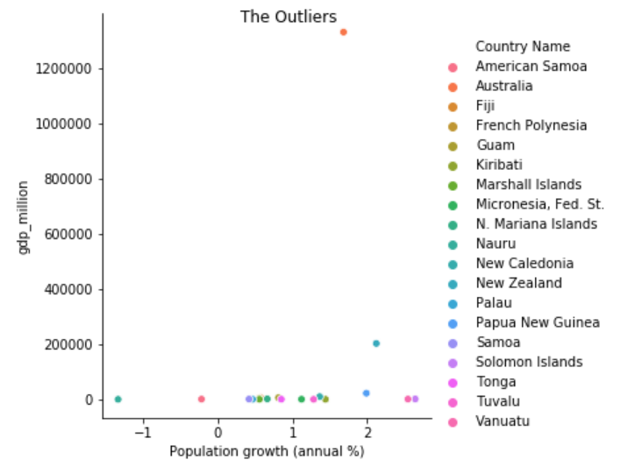
OUTLIERS
Australia
New Zealand
American Samoa
Nauru
Notes:
Outlier 1): Australia and New Zealand
The GDP of these two countries are much higher compared to other countries of this region. So we feel it is not appropriate to include these two countries in the analysis to get accurate insights of this region
Outlier 2) :American samoa and Nauru
The population growth in these regions are negative, this is because more people are migrating out of the country compared to the birth rate.

Slide 9
STRATEGY FOR ANALYSIS
Australasia
Independent
Melanesia
Independent
Micronesia
Independent
Polynesia
Territories
Australia
New Zealand
Fiji
Papua New Guinea
Solomon Islands
Vanuatu
Kiribati
Marshall Islands
Micronesia, Fed. St.
Nauru
Palau
Samoa
Tonga
Tuvalu
American Samoa
French Polynesia
Guam
Northern Mariana Islands

Slide 10
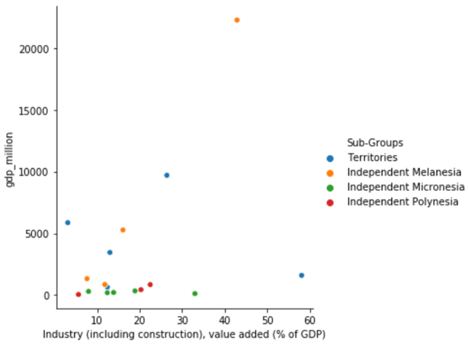
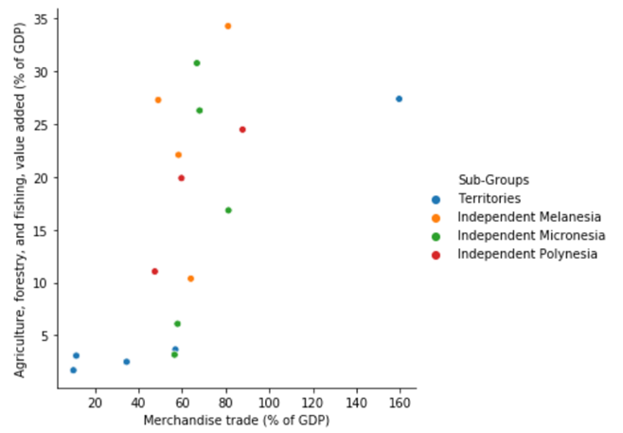
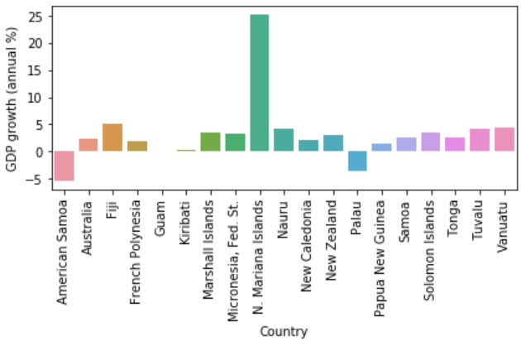
KEY INSIGHTS - GDP + Factors
Notes:
Script 1:
Most of the countries in this region have a heavy dependency in subsistence farming and fishing, and other small-scale economic activities. Turism is also a main economic source for this countries but the lack of proper infrastructure makes these countries inaccessible to tourist.
When you talk about the Service Industry, this is dominate by the public sector, more specific by government services. For the other side, the Financial Industry is underdeveloped due to the lack of proper infrastructure, Australia and New Zealand are the exception to this.
Nearly all industries in this region are privately own and are mostly related to mining. So if this countries want to improve their economic situation, the best way is to attract investors to develop their current industry infrastructure and reduce their dependence in the Service industry.
From our analysis, Australia and New Zealand are outliers due to the big difference between this countries with the rest of the region. Australia and Zealand are look like big investors for the rest of their neighbours, they posses rich natural resources like natural gas, coal, gold, iron ore, which have contribute to their economic and social success.

Slide 11
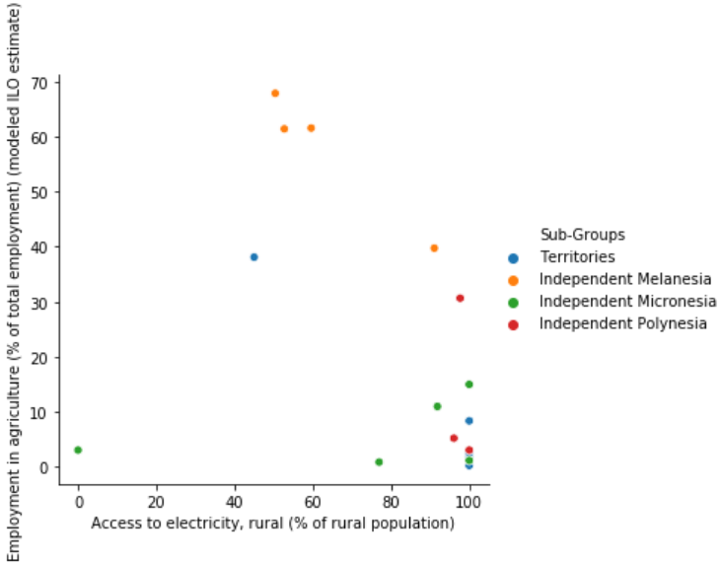
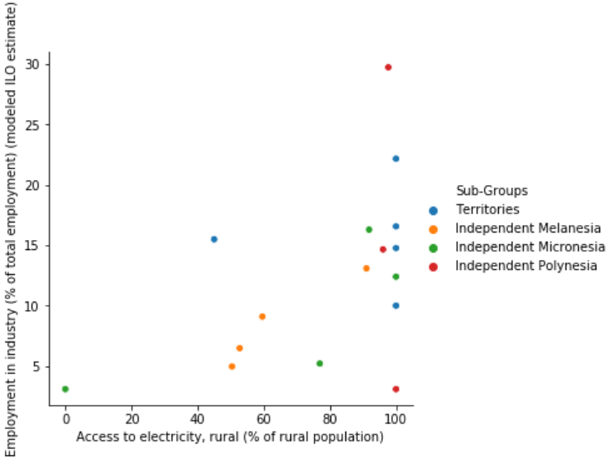
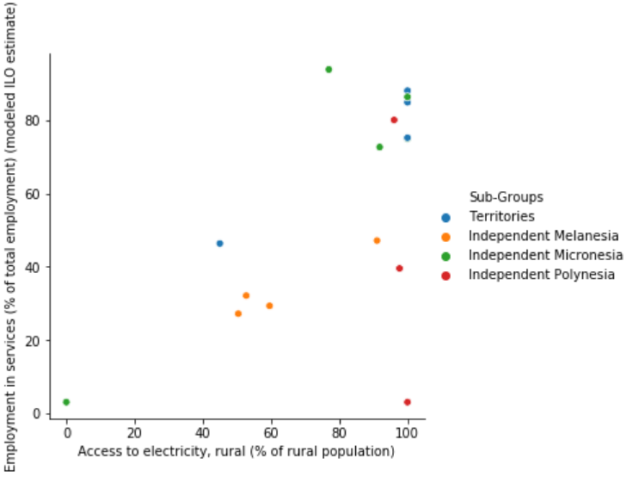
People & Resources - Scatter plots for
Access to Electricity in Rural Areas vs Employment in different Sectors
Notes:
Script 1:
Story of Melanesia
Fiji is an outlier as the country has the most developed formal sector as compared to the remaining countries in the sub region. (Misachi, 2017)
Countries in Melanesia is more involved in subsistence farming and have a small formal sector. A strong negative correlation was observed between employment in agriculture and rural access to electricity. On extensive research we found there is no agricultural technologies put in place in these areas and the government has limited budget to provide these technologies. They also don’t reach out to the rural population. (International Fund for Agricultural Development, n.d.)
A strong positive correlation between people working in industrial and service sector with access to electricity in rural area. For example: Papua New Guinea has mining sector which employs many individuals and its situated in the outskirts. These industries utilize heavy machineries which require electricity to operate. (Central Intelligence Agency, n.d.).
There is also a positive correlation between people working in service sector to access to electricity in urban area, this accounts for the hotels and other amenities running in country for tourism. (Central Intelligence Agency, n.d.).
Story of Polynesia
Countries in Polynesia are depended on foreign aid and the revenue is derived from tourism and foreign remittance. (Polynesia, n.d.)
The working population in Polynesia showed a strong positive correlation between agricultural and industrial sector employment with access to electricity in rural areas. On Careful examination, it was observed that these countries are having a more rural population as compared to urban, and these sectors are placed in rural areas. For example: In Samoa and Tonga fishing and agricultural products exports (Central Intelligence Agency, n.d.)
Those employed in service sector showed strong positive correlation with access to electricity in service sector. On careful examination we find that the countries have tourism (hotels) where many people are employed.
Story of Micronesia
The countries in this region is dependent on foreign aid from Australia and United states. The countries include Kiribati, Marshall islands, Micronesia Federation, Nauru, and Palau. The outlier here is Federated states of Micronesia which has significantly higher rural population, employed in public sectors, and Nauru where the electricity is accessible for 100% of urban population and it does not have a rural population.
It was observed that the access to electricity in rural areas has positive and direct correlation to employment in industrial sector and agriculture sector. For Example: Kiribati culturally is more involved in fisheries and subsistence farming. They also have a copra milling company for processing. (Find agriculture Expertise in Kiribati, n.d.) The access to electricity in urban areas has direct correlation with employment in industrial and services sector. For Example: Nauru has phosphate mining industry which employs many people. (Central Intelligence Agency, n.d.)
Territories:
Strong correlation between employment in service sector and access to rural and urban electricity.
For example: French Polynesia, the people are employed in countries are military bases and most of the people are employed in tourist industry or in military. (Central Intelligence Agency, n.d.)
Script2:
Melanesia
Rural population works mostly in agricultural sector. The positive correlation between age dependency ratio and the employment in agriculture shows that the working individuals with kids or parents depending on them is involved in agriculture. On careful observation, it was seen that the region is involved in subsistence farming, where the agricultural plot is a family plot.
Urban population works mostly in industrial and service sector. The region has a tourist industry. Countries like Papua New Guinea has mining sector which employs many individuals. (Central Intelligence Agency, n.d.)
Polynesia
Most of the urban population is employed in agriculture and industrial sector. It was observed that countries like Samoa has 2/3 of their population employed in agriculture and associated manufacturing industry. (Country profile- Samoa, n.d.)
The rural population is employed in service sector. The age dependency ratio is positively correlated with the service sector. Upon careful analysis it was observed that the countries in Polynesia, have a working population who support family, by working abroad and send home foreign remittance. (Central Intelligence Agency, n.d.)
Micronesia
The rural population is employed in the agricultural sector and the age dependency ratio is positively correlated to the agricultural sector, which implies the working-class population support their families by being employed in agricultural sector. For example, Countries like Federated states of Micronesia has subsistence farming and fishing. (Central Intelligence Agency, n.d.)
The urban population is employed in industry and service sector. For example, Nauru has both a phosphate mining and tourism service sector which employs their urban population. (Central Intelligence Agency, n.d.)
Territories
The territories are supported financially by countries like United States and France.
The rural population is employed in industrial sector. For example, American Samoa has high rural population amongst other territories. It has a tuna processing industry which employs their people. (Central Intelligence Agency, n.d.)

Slide 12
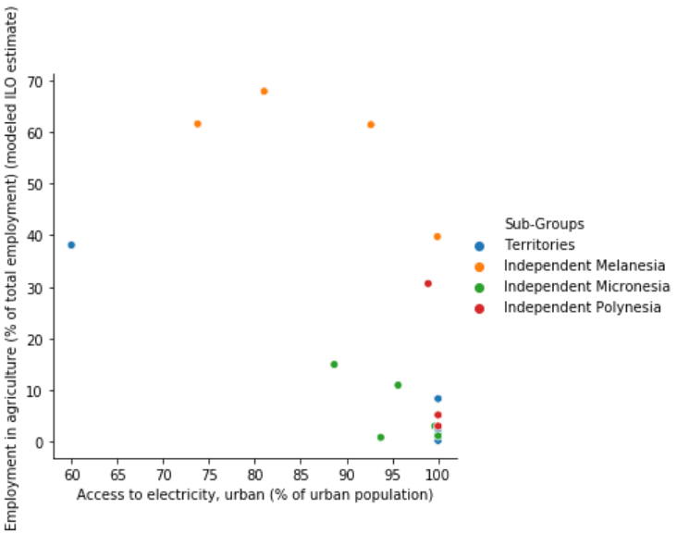
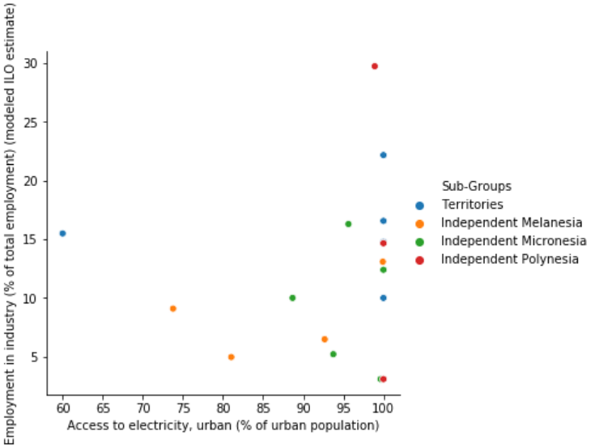

People & Resources - Scatter plots for
Access to Electricity in Urban Areas vs Employment in different Sectors
Notes:
Script 1:
Story of Melanesia
Fiji is an outlier as the country has the most developed formal sector as compared to the remaining countries in the sub region. (Misachi, 2017)
Countries in Melanesia is more involved in subsistence farming and have a small formal sector. A strong negative correlation was observed between employment in agriculture and rural access to electricity. On extensive research we found there is no agricultural technologies put in place in these areas and the government has limited budget to provide these technologies. They also don’t reach out to the rural population. (International Fund for Agricultural Development, n.d.)
A strong positive correlation between people working in industrial and service sector with access to electricity in rural area. For example: Papua New Guinea has mining sector which employs many individuals and its situated in the outskirts. These industries utilize heavy machineries which require electricity to operate. (Central Intelligence Agency, n.d.).
There is also a positive correlation between people working in service sector to access to electricity in urban area, this accounts for the hotels and other amenities running in country for tourism. (Central Intelligence Agency, n.d.).
Story of Polynesia
Countries in Polynesia are depended on foreign aid and the revenue is derived from tourism and foreign remittance. (Polynesia, n.d.)
The working population in Polynesia showed a strong positive correlation between agricultural and industrial sector employment with access to electricity in rural areas. On Careful examination, it was observed that these countries are having a more rural population as compared to urban, and these sectors are placed in rural areas. For example: In Samoa and Tonga fishing and agricultural products exports (Central Intelligence Agency, n.d.)
Those employed in service sector showed strong positive correlation with access to electricity in service sector. On careful examination we find that the countries have tourism (hotels) where many people are employed.
Story of Micronesia
The countries in this region is dependent on foreign aid from Australia and United states. The countries include Kiribati, Marshall islands, Micronesia Federation, Nauru, and Palau. The outlier here is Federated states of Micronesia which has significantly higher rural population, employed in public sectors, and Nauru where the electricity is accessible for 100% of urban population and it does not have a rural population.
It was observed that the access to electricity in rural areas has positive and direct correlation to employment in industrial sector and agriculture sector. For Example: Kiribati culturally is more involved in fisheries and subsistence farming. They also have a copra milling company for processing. (Find agriculture Expertise in Kiribati, n.d.) The access to electricity in urban areas has direct correlation with employment in industrial and services sector. For Example: Nauru has phosphate mining industry which employs many people. (Central Intelligence Agency, n.d.)
Territories:
Strong correlation between employment in service sector and access to rural and urban electricity.
For example: French Polynesia, the people are employed in countries are military bases and most of the people are employed in tourist industry or in military. (Central Intelligence Agency, n.d.)
Script2:
Melanesia
Rural population works mostly in agricultural sector. The positive correlation between age dependency ratio and the employment in agriculture shows that the working individuals with kids or parents depending on them is involved in agriculture. On careful observation, it was seen that the region is involved in subsistence farming, where the agricultural plot is a family plot.
Urban population works mostly in industrial and service sector. The region has a tourist industry. Countries like Papua New Guinea has mining sector which employs many individuals. (Central Intelligence Agency, n.d.)
Polynesia
Most of the urban population is employed in agriculture and industrial sector. It was observed that countries like Samoa has 2/3 of their population employed in agriculture and associated manufacturing industry. (Country profile- Samoa, n.d.)
The rural population is employed in service sector. The age dependency ratio is positively correlated with the service sector. Upon careful analysis it was observed that the countries in Polynesia, have a working population who support family, by working abroad and send home foreign remittance. (Central Intelligence Agency, n.d.)
Micronesia
The rural population is employed in the agricultural sector and the age dependency ratio is positively correlated to the agricultural sector, which implies the working-class population support their families by being employed in agricultural sector. For example, Countries like Federated states of Micronesia has subsistence farming and fishing. (Central Intelligence Agency, n.d.)
The urban population is employed in industry and service sector. For example, Nauru has both a phosphate mining and tourism service sector which employs their urban population. (Central Intelligence Agency, n.d.)
Territories
The territories are supported financially by countries like United States and France.
The rural population is employed in industrial sector. For example, American Samoa has high rural population amongst other territories. It has a tuna processing industry which employs their people. (Central Intelligence Agency, n.d.)

Slide 13
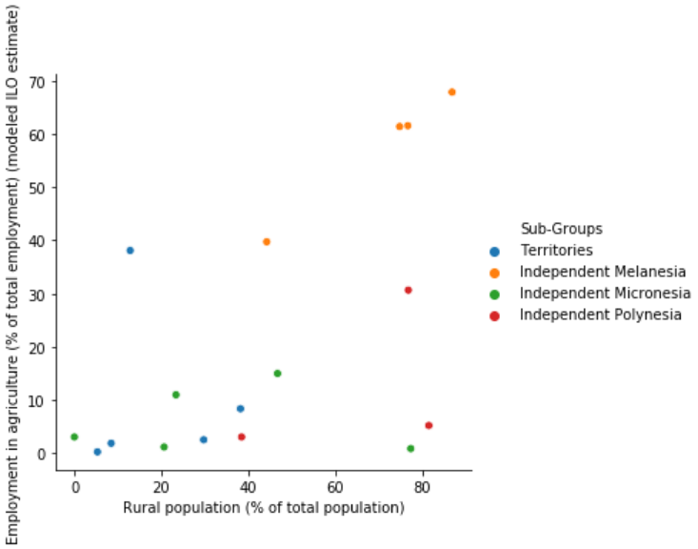
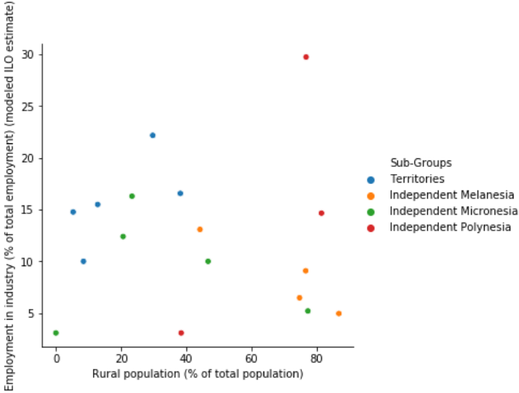
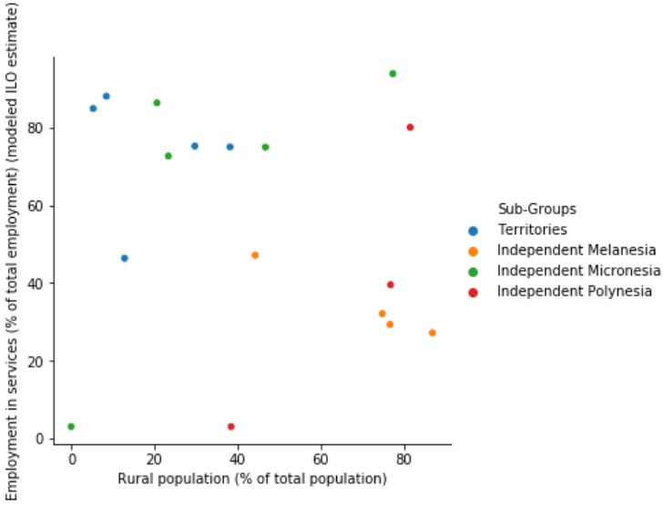
People - Scatter plots for
Rural Population vs Employment in different Sectors
Notes:
Script 1:
Story of Melanesia
Fiji is an outlier as the country has the most developed formal sector as compared to the remaining countries in the sub region. (Misachi, 2017)
Countries in Melanesia is more involved in subsistence farming and have a small formal sector. A strong negative correlation was observed between employment in agriculture and rural access to electricity. On extensive research we found there is no agricultural technologies put in place in these areas and the government has limited budget to provide these technologies. They also don’t reach out to the rural population. (International Fund for Agricultural Development, n.d.)
A strong positive correlation between people working in industrial and service sector with access to electricity in rural area. For example: Papua New Guinea has mining sector which employs many individuals and its situated in the outskirts. These industries utilize heavy machineries which require electricity to operate. (Central Intelligence Agency, n.d.).
There is also a positive correlation between people working in service sector to access to electricity in urban area, this accounts for the hotels and other amenities running in country for tourism. (Central Intelligence Agency, n.d.).
Story of Polynesia
Countries in Polynesia are depended on foreign aid and the revenue is derived from tourism and foreign remittance. (Polynesia, n.d.)
The working population in Polynesia showed a strong positive correlation between agricultural and industrial sector employment with access to electricity in rural areas. On Careful examination, it was observed that these countries are having a more rural population as compared to urban, and these sectors are placed in rural areas. For example: In Samoa and Tonga fishing and agricultural products exports (Central Intelligence Agency, n.d.)
Those employed in service sector showed strong positive correlation with access to electricity in service sector. On careful examination we find that the countries have tourism (hotels) where many people are employed.
Story of Micronesia
The countries in this region is dependent on foreign aid from Australia and United states. The countries include Kiribati, Marshall islands, Micronesia Federation, Nauru, and Palau. The outlier here is Federated states of Micronesia which has significantly higher rural population, employed in public sectors, and Nauru where the electricity is accessible for 100% of urban population and it does not have a rural population.
It was observed that the access to electricity in rural areas has positive and direct correlation to employment in industrial sector and agriculture sector. For Example: Kiribati culturally is more involved in fisheries and subsistence farming. They also have a copra milling company for processing. (Find agriculture Expertise in Kiribati, n.d.) The access to electricity in urban areas has direct correlation with employment in industrial and services sector. For Example: Nauru has phosphate mining industry which employs many people. (Central Intelligence Agency, n.d.)
Territories:
Strong correlation between employment in service sector and access to rural and urban electricity.
For example: French Polynesia, the people are employed in countries are military bases and most of the people are employed in tourist industry or in military. (Central Intelligence Agency, n.d.)
Script2:
Melanesia
Rural population works mostly in agricultural sector. The positive correlation between age dependency ratio and the employment in agriculture shows that the working individuals with kids or parents depending on them is involved in agriculture. On careful observation, it was seen that the region is involved in subsistence farming, where the agricultural plot is a family plot.
Urban population works mostly in industrial and service sector. The region has a tourist industry. Countries like Papua New Guinea has mining sector which employs many individuals. (Central Intelligence Agency, n.d.)
Polynesia
Most of the urban population is employed in agriculture and industrial sector. It was observed that countries like Samoa has 2/3 of their population employed in agriculture and associated manufacturing industry. (Country profile- Samoa, n.d.)
The rural population is employed in service sector. The age dependency ratio is positively correlated with the service sector. Upon careful analysis it was observed that the countries in Polynesia, have a working population who support family, by working abroad and send home foreign remittance. (Central Intelligence Agency, n.d.)
Micronesia
The rural population is employed in the agricultural sector and the age dependency ratio is positively correlated to the agricultural sector, which implies the working-class population support their families by being employed in agricultural sector. For example, Countries like Federated states of Micronesia has subsistence farming and fishing. (Central Intelligence Agency, n.d.)
The urban population is employed in industry and service sector. For example, Nauru has both a phosphate mining and tourism service sector which employs their urban population. (Central Intelligence Agency, n.d.)
Territories
The territories are supported financially by countries like United States and France.
The rural population is employed in industrial sector. For example, American Samoa has high rural population amongst other territories. It has a tuna processing industry which employs their people. (Central Intelligence Agency, n.d.)

Slide 14
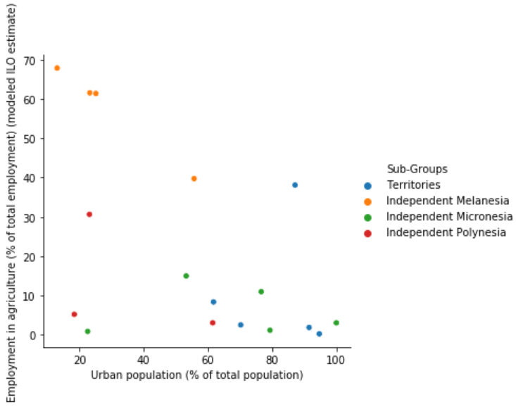
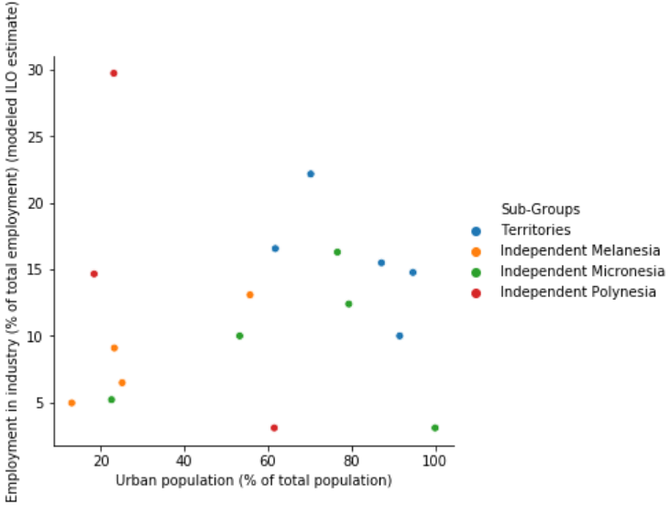
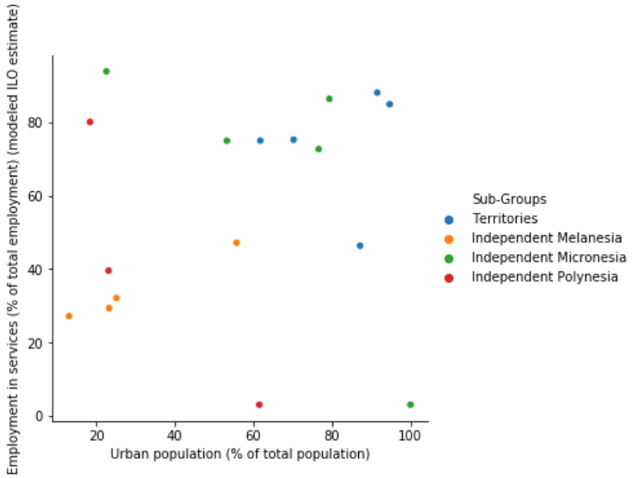
People - Scatter plots for
Urban Population vs Employment in different Sectors
Notes:
Script 1:
Story of Melanesia
Fiji is an outlier as the country has the most developed formal sector as compared to the remaining countries in the sub region. (Misachi, 2017)
Countries in Melanesia is more involved in subsistence farming and have a small formal sector. A strong negative correlation was observed between employment in agriculture and rural access to electricity. On extensive research we found there is no agricultural technologies put in place in these areas and the government has limited budget to provide these technologies. They also don’t reach out to the rural population. (International Fund for Agricultural Development, n.d.)
A strong positive correlation between people working in industrial and service sector with access to electricity in rural area. For example: Papua New Guinea has mining sector which employs many individuals and its situated in the outskirts. These industries utilize heavy machineries which require electricity to operate. (Central Intelligence Agency, n.d.).
There is also a positive correlation between people working in service sector to access to electricity in urban area, this accounts for the hotels and other amenities running in country for tourism. (Central Intelligence Agency, n.d.).
Story of Polynesia
Countries in Polynesia are depended on foreign aid and the revenue is derived from tourism and foreign remittance. (Polynesia, n.d.)
The working population in Polynesia showed a strong positive correlation between agricultural and industrial sector employment with access to electricity in rural areas. On Careful examination, it was observed that these countries are having a more rural population as compared to urban, and these sectors are placed in rural areas. For example: In Samoa and Tonga fishing and agricultural products exports (Central Intelligence Agency, n.d.)
Those employed in service sector showed strong positive correlation with access to electricity in service sector. On careful examination we find that the countries have tourism (hotels) where many people are employed.
Story of Micronesia
The countries in this region is dependent on foreign aid from Australia and United states. The countries include Kiribati, Marshall islands, Micronesia Federation, Nauru, and Palau. The outlier here is Federated states of Micronesia which has significantly higher rural population, employed in public sectors, and Nauru where the electricity is accessible for 100% of urban population and it does not have a rural population.
It was observed that the access to electricity in rural areas has positive and direct correlation to employment in industrial sector and agriculture sector. For Example: Kiribati culturally is more involved in fisheries and subsistence farming. They also have a copra milling company for processing. (Find agriculture Expertise in Kiribati, n.d.) The access to electricity in urban areas has direct correlation with employment in industrial and services sector. For Example: Nauru has phosphate mining industry which employs many people. (Central Intelligence Agency, n.d.)
Territories:
Strong correlation between employment in service sector and access to rural and urban electricity.
For example: French Polynesia, the people are employed in countries are military bases and most of the people are employed in tourist industry or in military. (Central Intelligence Agency, n.d.)
Script2:
Melanesia
Rural population works mostly in agricultural sector. The positive correlation between age dependency ratio and the employment in agriculture shows that the working individuals with kids or parents depending on them is involved in agriculture. On careful observation, it was seen that the region is involved in subsistence farming, where the agricultural plot is a family plot.
Urban population works mostly in industrial and service sector. The region has a tourist industry. Countries like Papua New Guinea has mining sector which employs many individuals. (Central Intelligence Agency, n.d.)
Polynesia
Most of the urban population is employed in agriculture and industrial sector. It was observed that countries like Samoa has 2/3 of their population employed in agriculture and associated manufacturing industry. (Country profile- Samoa, n.d.)
The rural population is employed in service sector. The age dependency ratio is positively correlated with the service sector. Upon careful analysis it was observed that the countries in Polynesia, have a working population who support family, by working abroad and send home foreign remittance. (Central Intelligence Agency, n.d.)
Micronesia
The rural population is employed in the agricultural sector and the age dependency ratio is positively correlated to the agricultural sector, which implies the working-class population support their families by being employed in agricultural sector. For example, Countries like Federated states of Micronesia has subsistence farming and fishing. (Central Intelligence Agency, n.d.)
The urban population is employed in industry and service sector. For example, Nauru has both a phosphate mining and tourism service sector which employs their urban population. (Central Intelligence Agency, n.d.)
Territories
The territories are supported financially by countries like United States and France.
The rural population is employed in industrial sector. For example, American Samoa has high rural population amongst other territories. It has a tuna processing industry which employs their people. (Central Intelligence Agency, n.d.)

Slide 15
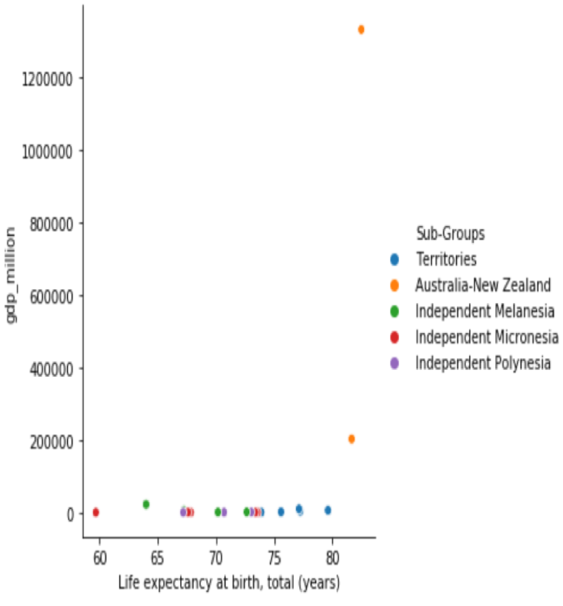
Healthcare
Notes:
Life Expectancy vs GDP
Melanesia +ve
In Melanesia, healthcare costs are unaffordable to many residents, and diseases such as diabetes as well as obesity and cardiovascular problems became a big concern in the region and brought down life expectancy. With the increase in GDP and imports, traditional foods became less appealing, and poor diets started forming from eating more imported foods (Pacific islanders pay heavy price for abandoning traditional diet, 2011). Moreover, info about mortality are not disclosed in a proper manner, and lead to inaccurate life expectancy data in this underdeveloped region (Taylor, 2004).
Polynesia +ve
As GDP grew, the standard living improved, and that was shown when comparing the number of people that were pushed below $3.10 poverty line due to health care costs vs GDP. That meant that people were not going into poverty due to healthcare and were able to have a better life expectancy.
Micronesia +ve
With the growth of GDP, this region spent more on healthcare, which led to higher life expectancy in these countries (Department of Health and Social Affairs FSM National Government, 2005).
Territories +ve
The countries in the region are territories of large and developed countries. The increase in this regions GDP comes from external aid which leads to an improved healthcare system in these countries. For example, Guam gets medical assistance from the US under FMAP (Federal Medical Assistance Program), which improves healthcare and leads to longer life expectancy (Guam, n.d.).
Number of People Pushed Below $3.10 Poverty Line Due to Healthcare Cost Vs Death Rate
Melanesia +ve
Due to expensive healthcare costs in this region, the people were pushed below the poverty line and were unable to afford healthcare (Hull, 1991), leading to an increase in death rates.
Poly +ve
Expensive healthcare in the region also pushed people into poverty, and the GDP and number of people pushed below the $3.10 was negative, meaning people were more able to afford healthcare, however the ones that were still in poverty, could not get the proper treatment and led to increase in death rates (Ames, 2014).
Micronesia -ve
The healthcare is this region is regulated and easily accessible to the population compared to the other regions (FSM PIHOA, n.d.). The correlation shows that the main causes of death in this region is not unaffordable health care, but other reasons such environmental challenges, and NCD’s (Non communicable diseases) which can become exceedingly expensive (Hardship & Vulnerability are Pressing Issues for Pacific Island Countries, n.d.).
Territories NO RELATION
Birth Rate Vs Adolescent Fertility Rate
Melanesia & Territories +ve
In this region, the women aged 15 to 19 have strong influence on the birth rate. This is a problem in this region where many young women had forced sexual encounters leading to pregnancies. Thus, the birth rate in this region is mainly due to adolescent pregnancies, and movements that acknowledge this fact are formed to protect these women. (Young Women’s Empowerment and Teenage Pregnancy in the Pacific, 2013).
Micronesia & Polynesia NO RELATION

Slide 16
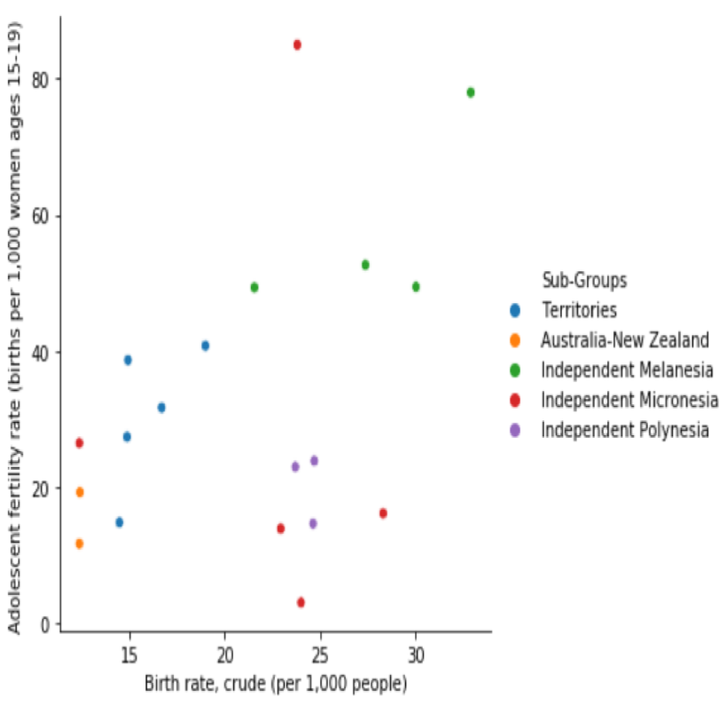
Healthcare
Notes:
Life Expectancy vs GDP
Melanesia +ve
In Melanesia, healthcare costs are unaffordable to many residents, and diseases such as diabetes as well as obesity and cardiovascular problems became a big concern in the region and brought down life expectancy. With the increase in GDP and imports, traditional foods became less appealing, and poor diets started forming from eating more imported foods (Pacific islanders pay heavy price for abandoning traditional diet, 2011). Moreover, info about mortality are not disclosed in a proper manner, and lead to inaccurate life expectancy data in this underdeveloped region (Taylor, 2004).
Polynesia +ve
As GDP grew, the standard living improved, and that was shown when comparing the number of people that were pushed below $3.10 poverty line due to health care costs vs GDP. That meant that people were not going into poverty due to healthcare and were able to have a better life expectancy.
Micronesia +ve
With the growth of GDP, this region spent more on healthcare, which led to higher life expectancy in these countries (Department of Health and Social Affairs FSM National Government, 2005).
Territories +ve
The countries in the region are territories of large and developed countries. The increase in this regions GDP comes from external aid which leads to an improved healthcare system in these countries. For example, Guam gets medical assistance from the US under FMAP (Federal Medical Assistance Program), which improves healthcare and leads to longer life expectancy (Guam, n.d.).
Number of People Pushed Below $3.10 Poverty Line Due to Healthcare Cost Vs Death Rate
Melanesia +ve
Due to expensive healthcare costs in this region, the people were pushed below the poverty line and were unable to afford healthcare (Hull, 1991), leading to an increase in death rates.
Poly +ve
Expensive healthcare in the region also pushed people into poverty, and the GDP and number of people pushed below the $3.10 was negative, meaning people were more able to afford healthcare, however the ones that were still in poverty, could not get the proper treatment and led to increase in death rates (Ames, 2014).
Micronesia -ve
The healthcare is this region is regulated and easily accessible to the population compared to the other regions (FSM PIHOA, n.d.). The correlation shows that the main causes of death in this region is not unaffordable health care, but other reasons such environmental challenges, and NCD’s (Non communicable diseases) which can become exceedingly expensive (Hardship & Vulnerability are Pressing Issues for Pacific Island Countries, n.d.).
Territories NO RELATION
Birth Rate Vs Adolescent Fertility Rate
Melanesia & Territories +ve
In this region, the women aged 15 to 19 have strong influence on the birth rate. This is a problem in this region where many young women had forced sexual encounters leading to pregnancies. Thus, the birth rate in this region is mainly due to adolescent pregnancies, and movements that acknowledge this fact are formed to protect these women. (Young Women’s Empowerment and Teenage Pregnancy in the Pacific, 2013).
Micronesia & Polynesia NO RELATION

Slide 17
CONCLUSION
Colonial neglect and historical isolation
Dependency on other countries
Diverse range of indigenous cultures
Small and vulnerable societies
Climate change and natural disasters
Threatening demographic trends

Slide 18
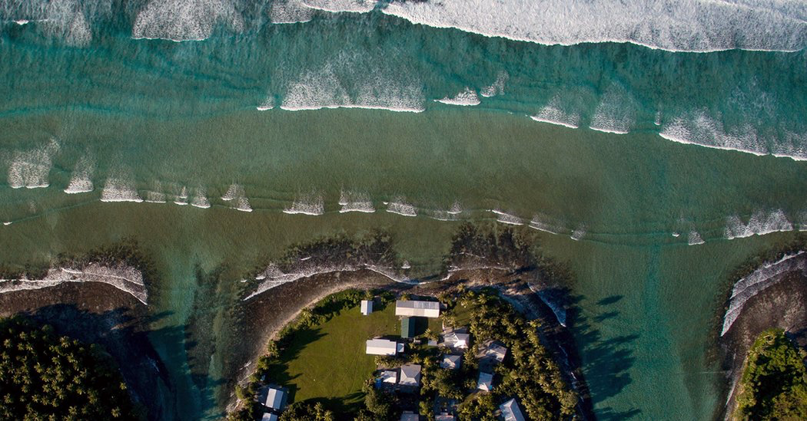


Slide 19
REFERENCES(1)
National Geographic. (n.d.). Australia and Oceania: Physical Geography. National Geographic. Retrieved from: https://www.nationalgeographic.org/encyclopedia/oceania-physical-geography/.
United Nations. (2017). Statistical Yearbook 2017 Edition. United Nations. Retrieved from: https://unstats.un.org/unsd/publications/statistical-yearbook/files/syb60/syb60.pdf.
World Bank. (n.d.). Educational attainment, at least Master's or equivalent, population 25+, total (%) (cumulative). World Bank. Retrieved from: https://data.worldbank.org/indicator/SE.TER.CUAT.MS.ZS.
World Bank. (n.d.). Why is there missing data for high-income countries? World Bank. Retrieved from: https://datahelpdesk.worldbank.org/knowledgebase/articles/198559-why-is-there-missing-data-for-high-income-countrie.
World Bank. (n.d.). Why are some data not available? World Bank. Retrieved from: https://datahelpdesk.worldbank.org/knowledgebase/articles/191133-why-are-some-data-not-available.
World Bank. (n.d.). How does the World Bank classify countries? World Bank. Retrieved from: https://datahelpdesk.worldbank.org/knowledgebase/articles/378834-how-does-the-world-bank-classify-countries.
IndexMundi. (n.d.). GINI index (World Bank estimate) - Country Ranking. IndexMundi. Retrieved from: https://www.indexmundi.com/facts/indicators/SI.POV.GINI/rankings.
World Bank. (n.d.). American Samoa. World Bank. Retrieved from: https://datacatalog.worldbank.org/country/american-samoa.
Sheppard Software. (n.d.). Economy of Oceania. Sheppard Software. Retrieved from: http://www.sheppardsoftware.com/Oceaniaweb/factfile/Unique-facts-Oceania20.htm.
United Nations Population Fund. (2014, April). Population and Development Profiles: Pacific Island Countries. United Nations Population Fund. Retrieved from: https://pacific.unfpa.org/sites/default/files/pub-pdf/web__140414_UNFPAPopulationandDevelopmentProfiles-PacificSub-RegionExtendedv1LRv2_0.pdf.
Nations Online. (n.d.). Countries of Australia and Oceania. Nations Online. Retrieved from: https://www.nationsonline.org/oneworld/oceania.htm.
World Bank. (n.d.). Pacific island small states. World Bank. Retrieved from: https://data.worldbank.org/region/pacific-island-small-states

Slide 20
REFERENCES(2)
CNN. (2019, July 22). Why China is challenging Australia for influence over the Pacific Islands. CNN. Retrieved from: https://www.cnn.com/2019/07/22/asia/china-australia-pacific-investment-intl-hnk/index.html.
Lawson, S. (2018, June 26). CONTENDING SECURITY INTERESTS IN OCEANIA. SSANSE. Retrieved from: http://ams.hi.is/wp-content/uploads/2018/06/Contending-Security-Interests-in-Oceania-1.pdf.
Goiran, H. (2018, March 26). THE ROLE OF THE FRENCH MILITARY ON KEY ISSUES FOR OCEANIA. East-West Center. Retrieved from: https://www.eastwestcenter.org/publications/the-role-the-french-military-key-issues-oceania.
The Diplomat. (2011, August 3). Why Oceania Matters. The Diplomat. Retrieved from: https://thediplomat.com/2011/08/why-oceania-matters/.
U.S. Energy Information Administration. (2018, October 18). American Samoa Profile Analysis. U.S. Energy Information Administration. Retrieved from: https://www.eia.gov/state/analysis.php?sid=AQ.
Turner, R. (2007, July). AMERICAN SAMOA BUSINESS OPPORTUNITIES REPORT. U.S. Department of the Interior. Retrieved from: https://www.doi.gov/sites/doi.gov/files/migrated/oia/reports/upload/American-Samoa_Business-Opportunities_2007_FINAL.pdf.
U.S. Department of the Interior. (n.d.). American Samoa. U.S. Department of the Interior. Retrieved from: https://www.doi.gov/oia/islands/american-samoa.
US National Library of Medicine. (2015, May). Insights in Public Health
A Tale of Two Polities: Health in Independent and American Samoa. US National Library of Medicine. Retrieved from: https://www.ncbi.nlm.nih.gov/pmc/articles/PMC4443619/.
Samoa News. (2018, October 20). 2017 American Samoa Statistical Yearbook shows decline in population. Samoa News. Retrieved from: http://www.samoanews.com/local-news/2017-american-samoa-statistical-yearbook-shows-decline-population.
American Samoa Department of Commerce. (n.d.). Educational Institutions and Enrollment. American Samoa Department of Commerce. Retrieved from: https://americansamoa.prism.spc.int/social/education/educational-institutions-and-enrollment.
Internet World Stats. (n.d.). American Samoa
Internet usage, broadband and telecommunications reports. Retrieved from: https://www.internetworldstats.com/sp/as.htm.
University of Wisconsin-Madison Libraries. (n.d.). Country Statistical Yearbooks : Oceania. University of Wisconsin-Madison Libraries. Retrieved from: https://researchguides.library.wisc.edu/c.php?g=177700&p=1169249.

Slide 21
REFERENCES(3)
The Conversation. (2017, June 19). Income inequality exists in Australia, but the true picture may not be as bad as you thought. The Conversation. Retrieved from: https://theconversation.com/income-inequality-exists-in-australia-but-the-true-picture-may-not-be-as-bad-as-you-thought-75221.
Parliament of Australia. (2018, October 29). State Statistical Bulletin 2017-18. Parliament of Australia. Retrieved from: https://www.aph.gov.au/About_Parliament/Parliamentary_Departments/Parliamentary_Library/pubs/rp/rp1819/SSB-1718.
Statista. (2019, January 10). Australia - Statistics & Facts. Statista. Retrieved from: https://www.statista.com/topics/752/australia/.
Central Intelligence Agency. (n.d.). AUSTRALIA - OCEANIA :: AUSTRALIA. Central Intelligence Agency. Retrieved from:
https://www.cia.gov/library/publications/resources/the-world-factbook/geos/print_as.html.
Fiji Bureau of Statistics. (n.d.). Fiji Statistics at a Glance. Fiji Bureau of Statistics. Retrieved from: https://www.statsfiji.gov.fj/.
Central Intelligence Agency. (n.d.). AUSTRALIA - OCEANIA :: FIJI. Central Intelligence Agency. Retrieved from: https://www.cia.gov/library/publications/the-world-factbook/geos/fj.html.
The Fijian Government. (2018, October 1). Fiji Bureau of Statistics Releases 2017 Census Results. The Fijian Government. Retrieved from: https://www.fiji.gov.fj/Media-Centre/News/Fiji-Bureau-of-Statistics-Releases-2017-Census-Res.
Central Intelligence Agency. (n.d.). AUSTRALIA - OCEANIA :: PALAU. Central Intelligence Agency. Retrieved from: https://www.cia.gov/library/publications/resources/the-world-factbook/geos/print_ps.html.
Countrymeters. (n.d.). Palau Population. Countrymeters. Retrieved from: https://countrymeters.info/en/Palau#literacy.
Theodora. (2019, February 8). Palau Economy 2019. Theodora. Retrieved from: https://theodora.com/wfbcurrent/palau/palau_economy.html.
IndexMundi. (2018, January 20). Palau Total fertility rate. IndexMundi. Retrieved from: https://www.indexmundi.com/palau/total_fertility_rate.html
https://countrymeters.info/en/Palau#literacy.
TRADING ECONOMICS. (n.d.). Palau - Urban population (% of total). TRADING ECONOMICS. Retrieved from: https://tradingeconomics.com/palau/urban-population-percent-of-total-wb-data.html#targetText=Urban%20population%20(%25%20of%20total)%20in%20Palau%20was%20reported%20at,compiled%20from%20officially%20recognized%20sources.&targetText=Urban%20population%20refers%20to%20people,defined%20by%20national%20statistical%20offices.

Slide 22
REFERENCES(4)
Central Intelligence Agency. (n.d.). AUSTRALIA - OCEANIA :: PAPUA NEW GUINEA. Central Intelligence Agency. Retrieved from:
https://www.cia.gov/library/publications/resources/the-world-factbook/geos/print_pp.html.
Education Policy and Data Center. (2018). Papua New Guinea. Education Policy and Data Center. Retrieved from: https://www.epdc.org/sites/default/files/documents/EPDC_NEP_2018_PapuaNewGuinea.pdf.
Countrymeters. (n.d.). Papua New Guinea Population. Countrymeters. Retrieved from: https://countrymeters.info/en/Papua_New_Guinea#literacy.
Papua New Guinea Today. (2018, April 6). First Papua New Guinean Graduate with PhD in Electrical Engineering at University of Technology. Papua New Guinea Today. Retrieved from: https://news.pngfacts.com/2018/04/first-papua-new-guinean-graduate-with.html.
Countrymeters. (n.d.). Samoa Population. Countrymeters. Retrieved from: https://countrymeters.info/en/Samoa#literacy.
Central Intelligence Agency. (n.d.). AUSTRALIA - OCEANIA :: SAMOA. Central Intelligence Agency. Retrieved from:
https://www.cia.gov/library/publications/the-world-factbook/geos/print_ws.html.
TRADING ECONOMICS. (n.d.). Samoa - Urban population (% of total). TRADING ECONOMICS. Retrieved from: https://tradingeconomics.com/samoa/urban-population-percent-of-total-wb-data.html#targetText=Urban%20population%20(%25%20of%20total)%20in%20Samoa%20was%20reported%20at,compiled%20from%20officially%20recognized%20sources.&targetText=Urban%20population%20refers%20to%20people,defined%20by%20national%20statistical%20offices.
Central Intelligence Agency. (n.d.). AUSTRALIA - OCEANIA :: FRENCH POLYNESIA. Central Intelligence Agency. Retrieved from:
https://www.cia.gov/library/publications/the-world-factbook/geos/fp.html.
StateUniversity. (n.d.). French Polynesia. StateUniversity. Retrieved from:
https://education.stateuniversity.com/pages/489/French-Polynesia.html.
TRADING ECONOMICS. (n.d.). French Polynesia - Urban population (% of total). TRADING ECONOMICS. Retrieved from:
https://tradingeconomics.com/french-polynesia/urban-population-percent-of-total-wb-data.htm.
Central Intelligence Agency. (n.d.). AUSTRALIA - OCEANIA :: GUAM. Central Intelligence Agency. Retrieved from: https://www.cia.gov/library/publications/the-world-factbook/geos/gq.html.
Phrasebase. (n.d.). Guam Facts. Phrasebase. Retrieved from: http://www.phrasebase.com/countries/guam/.

Slide 23
REFERENCES(5)
Worldometers. (n.d.). Guam Population. Worldometers. Retrieved from:
https://www.worldometers.info/world-population/guam-population/.
TRADING ECONOMICS. (n.d.). Kiribati - Employment in industry (% of total employment). TRADING ECONOMICS. Retrieved from: https://tradingeconomics.com/kiribati/employment-in-industry-percent-of-total-employment-wb-data.html.
Worldometers. (n.d.). Kiribati Population. Worldometers. Retrieved from: https://www.worldometers.info/world-population/kiribati-population/.
World Population Review. (n.d.). Population of Cities in Kiribati. World Population Review. Retrieved from: http://worldpopulationreview.com/countries/kiribati-population/cities/.
Encyclopædia Britannica. (n.d.). Nauru History. Encyclopædia Britannica. Retrieved from: https://www.britannica.com/place/Nauru/History.
Energy Sector Management Assistance Program. (n.d.). Nauru. Energy Sector Management Assistance Program. Retrieved from: https://trackingsdg7.esmap.org/country/nauru.
Countrymeters. (n.d.). Nauru Population. Countrymeters. Retrieved from: https://countrymeters.info/en/Nauru.
Central Intelligence Agency. (n.d.). AUSTRALIA - OCEANIA :: NAURU. Central Intelligence Agency. Retrieved from: https://www.cia.gov/library/publications/resources/the-world-factbook/geos/print_nr.html.
IndexMundi. (n.d.). Nauru Birth rate. IndexMundi. Retrieved from: https://www.indexmundi.com/nauru/birth_rate.html.
IndexMundi. (n.d.). Nauru Death rate. IndexMundi. Retrieved from: https://www.indexmundi.com/nauru/death_rate.html.
IndexMundi. (n.d.). Nauru Demographics. IndexMundi. Retrieved from: https://www.indexmundi.com/nauru/demographics_profile.html.
IndexMundi. (n.d.). Nauru - Rural population (% of total population). IndexMundi. Retrieved from: https://www.indexmundi.com/facts/nauru/indicator/SP.RUR.TOTL.ZS.
World Population Review. (n.d.). Nauru Population. World Population Review. Retrieved from: http://worldpopulationreview.com/countries/nauru-population/.
IndexMundi. (n.d.). Nauru Net migration rate. IndexMundi. Retrieved from: https://www.indexmundi.com/nauru/net_migration_rate.html.
Encyclopædia Britannica. (n.d.). New Caledonia. Encyclopædia Britannica. Retrieved from: https://www.britannica.com/place/New-Caledonia-French-unique-collectivity-Pacific-Ocean.

Slide 24
REFERENCES(6)
IndexMundi. (n.d.). New Caledonia Literacy. IndexMundi. Retrieved from: https://www.indexmundi.com/new_caledonia/literacy.html.
IndexMundi. (n.d.). Merchandise trade (% of GDP) - Country Ranking. IndexMundi. Retrieved from:
https://www.indexmundi.com/facts/indicators/TG.VAL.TOTL.GD.ZS/rankings.
IndexMundi. (n.d.). Mobile cellular subscriptions (per 100 people) - Country Ranking. IndexMundi. Retrieved from: https://www.indexmundi.com/facts/indicators/IT.CEL.SETS.P2/rankings.
Stats NZ. (n.d.). What New Zealand actually does for a living: from manufacturing to a services-oriented economy. Stats NZ. Retrieved from: http://archive.stats.govt.nz/browse_for_stats/economic_indicators/NationalAccounts/Contribution-to-gdp.aspx.
World Bank. (n.d.). Births attended by skilled health staff (% of total) - New Zealand. World Bank. Retrieved from: https://data.worldbank.org/indicator/SH.STA.BRTC.ZS?end=2015&locations=NZ&start=1994&view=chart.
Central Intelligence Agency. (n.d.). AUSTRALIA - OCEANIA :: NEW ZEALAND. Central Intelligence Agency. Retrieved from: https://www.cia.gov/library/publications/resources/the-world-factbook/geos/nz.html.
Education Counts. (n.d.). Total public expenditure on education. Education Counts. Retrieved from: https://www.educationcounts.govt.nz/statistics/indicators/main/resource/total_investment_in_education.
IndexMundi. (n.d.). New Zealand Literacy. IndexMundi. Retrieved from: https://www.indexmundi.com/new_zealand/literacy.html.
Central Intelligence Agency. (n.d.). AUSTRALIA - OCEANIA :: SOLOMON ISLANDS. Central Intelligence Agency. Retrieved from: https://www.cia.gov/library/publications/the-world-factbook/geos/bp.html.
Countrymeters. (n.d.). Solomon Islands Population. Countrymeters. Retrieved from: https://countrymeters.info/en/Solomon_Islands.
World Bank. (2009, December 3). Powering the Solomon Islands with reliable, affordable energy a challenge. World Bank. Retrieved from: http://blogs.worldbank.org/eastasiapacific/powering-the-solomon-islands-with-reliable-affordable-energy-a-challenge.
Central Intelligence Agency. (n.d.). AUSTRALIA - OCEANIA :: TONGA. Central Intelligence Agency. Retrieved from:
https://www.cia.gov/library/publications/the-world-factbook/geos/tn.html.
Central Intelligence Agency. (n.d.). AUSTRALIA - OCEANIA :: TUVALU. Central Intelligence Agency. Retrieved from: https://www.cia.gov/library/publications/the-world-factbook/geos/print_tv.html.
Wikipedia. (2019, September 18). Demographics of Tuvalu. Wikipedia. Retrieved from: https://en.wikipedia.org/wiki/Demographics_of_Tuvalu.

Slide 25
REFERENCES(7)
UNICEF. (n.d.). Tuvalu Statistics. UNICEF. Retrieved from: https://www.unicef.org/infobycountry/Tuvalu_statistics.html#121.
StateUniversity. (n.d.). Tuvalu. StateUniversity. Retrieved from: https://education.stateuniversity.com/pages/1582/Tuvalu.html.
The Commonwealth. (n.d.). Tuvalu : Economy. The Commonwealth. Retrieved from: https://thecommonwealth.org/our-member-countries/tuvalu/economy.
Central Intelligence Agency. (n.d.). AUSTRALIA - OCEANIA :: VANUATU. Central Intelligence Agency. Retrieved from: https://www.cia.gov/library/publications/the-world-factbook/geos/nh.html.
IndexMundi. (n.d.). Vanuatu - Access to electricity (% of population). IndexMundi. Retrieved from: https://www.indexmundi.com/facts/vanuatu/indicator/EG.ELC.ACCS.ZS.
Levine, V. (2013). Education in Pacific Island States. East-West Center. Retrieved from: https://www.eastwestcenter.org/sites/default/files/private/pip008.pdf.
UNESCO Institute of Statistics. (2018, October 7). Across the Pacific: Building Effective Education Management Information Systems. UNESCO Institute of Statistics. Retrieved from: http://uis.unesco.org/en/blog/across-pacific-building-effective-education-management-information-systems.
IndexMundi. (n.d.). Educational attainment, at least completed primary, population 25+ years, total (%) (cumulative) - Oceania. Retrieved from: https://www.indexmundi.com/facts/indicators/SE.PRM.CUAT.ZS/map/oceania.
Investopedia. (2019, September 18). Gini Index. Investopedia. Retrieved from: https://www.investopedia.com/terms/g/gini-index.asp.
IndexMundi. (n.d.). GINI index (World Bank estimate) - Oceania. Retrieved from: https://www.indexmundi.com/facts/indicators/SI.POV.GINI/map/oceania.
The University of the South Pacific. (2017, April 7). Pacific discusses Income Inequality. The University of the South Pacific. Retrieved from: https://www.usp.ac.fj/news/story.php?id=2386.
INTERNATIONAL MONETARY FUND. (2018, May 10). The Economic Impact of Natural Disasters in Pacific Island Countries: Adaptation and Preparedness. INTERNATIONAL MONETARY FUND. Retrieved from: https://www.imf.org/en/Publications/WP/Issues/2018/05/10/The-Economic-Impact-of-Natural-Disasters-in-Pacific-Island-Countries-Adaptation-and-45826.

Slide 26
REFERENCES(8)
BORGEN Magazine. (2016, September 27). What You Need to Know about Poverty in the Pacific Islands. BORGEN Magazine. Retrieved from: https://www.borgenmagazine.com/poverty-in-the-pacific-islands/.
Ministry of Social Development. (n.d.). Household Incomes in New Zealand: trends in indicators of inequality and hardship 1982 to 2017. Ministry of Social Development. Retrieved from: https://www.msd.govt.nz/about-msd-and-our-work/publications-resources/monitoring/household-incomes/.
Wikipedia. (2019, October 11). Marshall Islands. Wikipedia. Retrieved from: https://en.wikipedia.org/wiki/Marshall_Islands.
World Bank. (n.d.). Marshall Islands. World Bank. Retrieved from: https://data.worldbank.org/country/marshall-islands.
Central Intelligence Agency. (2019, October 2). AUSTRALIA - OCEANIA :: MARSHALL ISLANDS. Central Intelligence Agency. Retrieved from: https://www.cia.gov/library/publications/the-world-factbook/geos/rm.html.
StateUniversity. (n.d.). Marshall Islands. StateUniversity. Retrieved from: https://education.stateuniversity.com/pages/961/Marshall-Islands.html.
U.S. Department of Health & Human Services. (n.d.). OAH TEEN PREGNANCY PREVENTION PROGRAM: SPOTLIGHTING SUCCESS. U.S. Department of Health & Human Services. Retrieved from: https://www.hhs.gov/ash/oah/sites/default/files/tpp-spotlighting-success-marshall-islands.pdf.
U.S. Department of the Interior. (2012, February 14). The RMI 2011 Census of Population and Housing Summary and Highlights Only. U.S. Department of the Interior. Retrieved from: https://www.doi.gov/sites/doi.gov/files/migrated/oia/reports/upload/RMI-2011-Census-Summary-Report-on-Population-and-Housing.pdf.
Encyclopedia of the Nations. (n.d.). Births attended by skilled health staff (% of total) - Reproductive health - Health - World Development Indicators. Encyclopedia of the Nations. Retrieved from: https://www.nationsencyclopedia.com/WorldStats/WDI-health-births-attended-skilled-staff.html.
Macrotrends. (n.d.). Marshall Islands Education Spending 1999-2019. Macrotrends. Retrieved from: https://www.macrotrends.net/countries/MHL/marshall-islands/education-spending.
UNESCO Institute of Statistics. (n.d.). Marshall Islands. UNESCO Institute of Statistics. Retrieved from: http://uis.unesco.org/en/country/mh.
World Population Review. (n.d.). Marshall Islands Population 2019. World Population Review. Retrieved from: http://worldpopulationreview.com/countries/marshall-islands-population/.

Slide 27
REFERENCES(9)
TRADING ECONOMICS. (n.d.). Marshall Islands - Urban population (% of total). TRADING ECONOMICS. Retrieved from: https://tradingeconomics.com/marshall-islands/urban-population-percent-of-total-wb-data.html.
World Population Review. (n.d.). Population of Cities in Marshall Islands (2019). World Population Review. Retrieved from: http://worldpopulationreview.com/countries/marshall-islands-population/cities/.
The New York Times. (2015, December 2). The Marshall Islands Are Disappearing. The New York Times. Retrieved from: https://www.nytimes.com/interactive/2015/12/02/world/The-Marshall-Islands-Are-Disappearing.html.
Los Angeles Times. (2019, July 15). Radiation in parts of the Marshall Islands is far higher than Chernobyl, study says. Los Angeles Times. Retrieved from: https://www.latimes.com/nation/la-na-marshall-islands-radiation-20190715-story.html.
Atomic Heritage Foundation. (n.d.). Marshall Islands. Atomic Heritage Foundation. Retrieved from: https://www.atomicheritage.org/location/marshall-islands.
Smithsonian. (2018, June). Mapping Out What’s Next for the Marshall Islands. Smithsonian. Retrieved from: https://ocean.si.edu/conservation/climate-change/mapping-out-whats-next-marshall-islands.
Wikipedia. (2019, October 18). Federated States of Micronesia. Wikipedia. Retrieved from: https://en.wikipedia.org/wiki/Federated_States_of_Micronesia.
Wikipedia. (2019, October 20). Economy of the Federated States of Micronesia. Wikipedia. Retrieved from: https://en.wikipedia.org/wiki/Economy_of_the_Federated_States_of_Micronesia.
Central Intelligence Agency. (n.d.). AUSTRALIA - OCEANIA :: MICRONESIA, FEDERATED STATES OF. Central Intelligence Agency. Retrieved from: https://www.cia.gov/library/publications/the-world-factbook/geos/print_fm.html.
UNESCO Institute of Statistics. (n.d.). Micronesia (Federated States of). Retrieved from: http://uis.unesco.org/en/country/fm.
IndexMundi. (2015, June 30). Federated States of Micronesia Literacy. IndexMundi. Retrieved from: https://www.indexmundi.com/federated_states_of_micronesia/literacy.html.
World Bank. (2018, June 11). Micro Connections: Connecting the Federated States of Micronesia. World Bank. Retrieved from: https://www.worldbank.org/en/news/feature/2018/06/11/micro-connections-connecting-the-federated-states-of-micronesia.

Slide 28
REFERENCES(10)
UNICEF. (2017, December). Situation Analysis of Children in the Federated States of Micronesia. UNICEF. Retrieved from: https://www.unicef.org/pacificislands/06_Situation_Analysis_of_Children_Micronesia.pdf.
Wikipedia. (2019, October 27). Northern Mariana Islands. Wikipedia. Retrieved from: https://en.wikipedia.org/wiki/Northern_Mariana_Islands.
World Bank. (n.d.). Northern Mariana Islands. World Bank. Retrieved from: https://data.worldbank.org/country/northern-mariana-islands?view=chart.
Central Intelligence Agency. (n.d.). AUSTRALIA - OCEANIA :: NORTHERN MARIANA ISLANDS. Central Intelligence Agency. Retrieved from: https://www.cia.gov/library/publications/the-world-factbook/geos/cq.html.
TRADING ECONOMICS. (n.d.). Northern Mariana Islands - Mobile cellular subscriptions (per 100 people). TRADING ECONOMICS. Retrieved from: https://tradingeconomics.com/northern-mariana-islands/mobile-cellular-subscriptions-per-100-people-wb-data.html.
U.S. Department of Health & Human Services. (n.d.). Northern Mariana Islands Adolescent Reproductive Health Facts. U.S. Department of Health & Human Services. Retrieved from: https://www.hhs.gov/ash/oah/facts-and-stats/national-and-state-data-sheets/adolescent-reproductive-health/northern-mariana-islands/index.html.
Countrymeters. (n.d.). Northern Mariana Islands Population. Countrymeters. Retrieved from: https://countrymeters.info/en/Northern_Mariana_Islands.
IndexMundi. (2015, June 30). Northern Mariana Islands Literacy. IndexMundi. Retrieved from: https://www.indexmundi.com/northern_mariana_islands/literacy.html.
World Population Review. (n.d.). Northern Mariana Islands Population 2019. World Population Review. Retrieved from: http://worldpopulationreview.com/countries/northern-mariana-islands-population/.
Bureau of Economic Analysis. (2018, October 17). Northern Mariana Islands’ GDP Increases in 2017. Bureau of Economic Analysis. Retrieved from: https://www.bea.gov/news/blog/2018-10-17/northern-mariana-islands-gdp-increases-2017.
Moody’s Analytics. (n.d.). Northern Mariana Islands - Economic Indicators. Moody’s Analytics. Retrieved from: https://www.economy.com/northern-mariana-islands/indicators#ECONOMY.

Slide 29
REFERENCES(11)
Medium. (2017, November 21). Did the Northern Mariana Islands Experience a Baby Boom? Medium. Retrieved from: https://medium.com/migration-issues/did-the-northern-mariana-islands-experience-a-baby-boom-56b3a92a4b60.
The Conversation. (2017, August 6). Australia doesn’t ‘get’ the environmental challenges faced by Pacific Islander. The Conversation. Retrieved from: https://theconversation.com/australia-doesnt-get-the-environmental-challenges-faced-by-pacific-islanders-81995.
Cultural Survival. (1993, September). OCEANIA: ISLANDS, LAND, PEOPLE. Cultural Survival. Retrieved from: https://www.culturalsurvival.org/publications/cultural-survival-quarterly/oceania-islands-land-people.
National Geographic. (n.d.). Australia and Oceania: Human Geography. National Geographic. Retrieved from: https://www.nationalgeographic.org/encyclopedia/oceania-human-geography/.
ResearchGate. (2001, January). The Population of Oceania in the Second Millennium. ResearchGate. Retrieved from: https://www.researchgate.net/publication/267818571_The_Population_of_Oceania_in_the_Second_Millennium.
The Strategist. (2019, May 29). Three realities for the Pacific family and Australia’s step-up agenda. The Strategist. Retrieved from: https://www.aspistrategist.org.au/three-realities-for-the-pacific-family-and-australias-step-up-agenda/.
Rallu, J. (2010, January). The Demography of Oceania from the 1950s to the 2000s. CAIRN. Retrieved from: https://www.cairn-int.info/article-E_POPU_1001_0009--the-demography-of-oceania-from-the-1950s.htm.
Kahn, K. (2019, April 11). Micronesians Struggle to Access Health Care after Reaching US Shores. NPQ. Retrieved from: https://nonprofitquarterly.org/micronesians-struggle-to-access-health-care-after-reaching-us-shores/.
IEA. (2004, October 1). Contemporary patterns of Pacific Island mortality. IEA. Retrieved from: https://academic.oup.com/ije/article/34/1/207/638521.
WHO. (2011, March 4). Pacific islanders pay heavy price for abandoning traditional diet. WHO. Retrieved from: https://www.who.int/bulletin/volumes/88/7/10-010710/en/.
Medicaid. (n.d.). Guam. Retrieved from https://www.medicaid.gov/state-overviews/guam.html.
Cultural Survival. (1991, June 1). Health and Development: Seeking the Best of Both Worlds. Cultural Survival. Retrieved from: https://www.culturalsurvival.org/publications/cultural-survival-quarterly/health-and-development-seeking-best-both-worlds.

Slide 30
REFERENCES(12)
Ames, D. (2014, September 19). The Pacific Island Health Care Project. Frontiers. Retrieved from: https://www.frontiersin.org/articles/10.3389/fpubh.2014.00175/full.
PIHOA. (n.d.). Federated States of Micronesia (FSM). PIHOA. Retrieved from https://www.pihoa.org/fsm/.
World Bank. (2014, March 11). Hardship & Vulnerability are Pressing Issues for Pacific Island Countries. World Bank. Retrieved from: https://www.worldbank.org/en/news/press-release/2014/03/11/hardship-vulnerability-are-pressing-issues-for-pacific-island-countries-world-bank.
NewScientist. (2017, September 7). Eight low-lying Pacific islands swallowed whole by rising seas. NewScientist. Retrieved from: https://www.newscientist.com/article/2146594-eight-low-lying-pacific-islands-swallowed-whole-by-rising-seas/.
Stuff. (2019, October 3). In low-lying nations of Oceania people are already dying of climate change, report says. Stuff. Retrieved from: https://www.stuff.co.nz/environment/climate-news/116239262/in-lowlying-nations-of-oceania-people-are-already-dying-of-climate-change-report-says.
New York Post. (2019, July 15). Radiation levels in Marshall Islands still exceed Fukushima, Chernobyl: study. New York Post. Retrieved from: https://nypost.com/2019/07/15/radiation-levels-in-marshall-islands-still-exceed-fukushima-chernobyl-study/.
Department of Health and Social Affairs FSM National Government. (2005). Federated States Of Micronesia National Health Expenditure 2005-2008. Department of Health and Social Affairs FSM National Government. Retrieved from: http://www.wpro.who.int/southpacific/programmes/health_sector/health_financing/FSM_National_Health_Expenditure_20052008__Final_.pdf.
United Nations Population Fund. (2013). Young Women’s Empowerment and Teenage Pregnancy in the Pacific. United Nations Population Fund. Retrieved from: https://pacific.unfpa.org/sites/default/files/pub-pdf/UNFPASWOPPacificSupplementIamNotaLostCauseLR5final.pdf.
Misachi, J. (2017, April 11). Which Countries And Territories Make Up Melanesia? World Atlas. Retrieved October 30, 2019, from https://www.worldatlas.com/articles/which-countries-and-territories-make-up-melanesia.html.
New World Encyclopedia. (n.d.). Polynesia. New World Encyclopedia. Retrieved from: https://www.newworldencyclopedia.org/entry/Polynesia.
International Fund for Agricultural Development. (n.d.). Melanesia Rural Market & Innovation Development Driven Programme. International Fund for Agricultural Development. Retrieved from:: https://www.ifad.org/documents/38714174/41118097/APR-RIA_MERMAID+CN+Final.pdf/3a5d82a1-d58f-210d-297f-85b089c50a4d.

Slide 31
REFERENCES(13)
Commonwealth. (n.d.). Find agriculture Expertise in Kiribati. Commonwealth. Retrieved from: http://www.commonwealthofnations.org/sectors-kiribati/business/agriculture/.
New Agriculturist. (n.d.). Country profile- Samoa. New Agriculturist. Retrieved from: http://www.new-ag.info/en/country/profile.php?a=844.

